Slide 1

"Health Camp Data Integration and Analysis System"
VINAY S.GADADE

Slide 2

Problem statement
Design a data processing system to integrate and cleanse data from two tables, namely "first-health-camp-details" and "second-health-camp-details", while ensuring removal of duplicate entries.
The system should standardize all dates to the format dd/mm/yyyy and ensure that health scores are stored as floats with up to six digits.
The system should be capable of identifying patients who attended both health camps, extracting their health scores, and calculating the difference in their health scores.
Additionally, it should determine the start and end dates of each health camp based on the health-camp-id.
Furthermore, the system should be able to identify patients who did not attend either the first or second health camp.
Finally, it should generate a bar chart illustrating the number of patients based on health-camp-id to provide insights into attendance patterns.

Slide 3

INTRODUCTION
In the management of health camps, there is a critical need to integrate and cleanse data from multiple sources to ensure accuracy and consistency. This task involves processing data from two tables, "first-health-camp-details" and "second-health-camp-details," and requires the removal of duplicate entries while standardizing dates and health scores. The goal is to design a data processing system that can efficiently handle these tasks and provide valuable insights for health camp management.
Data Integration and Cleansing: Develop a system to merge data from the two tables, ensuring that duplicate entries are eliminated. Standardize dates to the format dd/mm/yyyy and store health scores as floats with up to six digits.
Patient Identification: Create functionality to identify patients who attended both health camps, extract their health scores, and calculate the difference in their scores. This will help in understanding the impact of multiple camp attendances on patients' health.
Health Camp Analysis: Determine the start and end dates of each health camp based on the health-camp-id. This information is crucial for scheduling future camps and analyzing their effectiveness.
Attendance Patterns: Generate a bar chart illustrating the number of patients based on health-camp-id. This visualization will provide insights into attendance patterns, helping in resource allocation and camp planning.
Identification of Non-Attendees: Develop a mechanism to identify patients who did not attend either the first or second health camp. Understanding the reasons for non-attendance can help in improving outreach and participation rates.

Slide 4
Data Sources
Health_Camp_Detail:
Health_Camp_ID
Camp_Start_Date
Camp_End_Date
Category1
Category2
Category3
Patient_Profile
Patient_ID
Online_Follower
LinkedIn_Shared
Twitter_Shared
Facebook_Shared
Income
Education_Score
Age
First_Interaction
City_Type
Employer_Category
First_Health_Camp_Attended
Patient_ID
Health_Camp_ID
Donation
Health_Score
Second_Health_Camp_Attended
Patient_ID
Health_Camp_ID
Donation
Health_Score

Slide 5
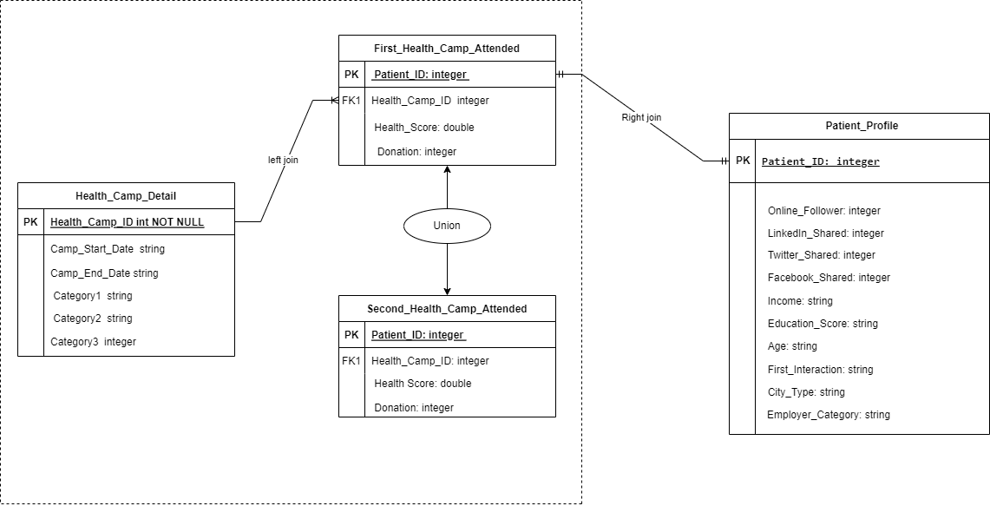
Data Integration

Slide 6
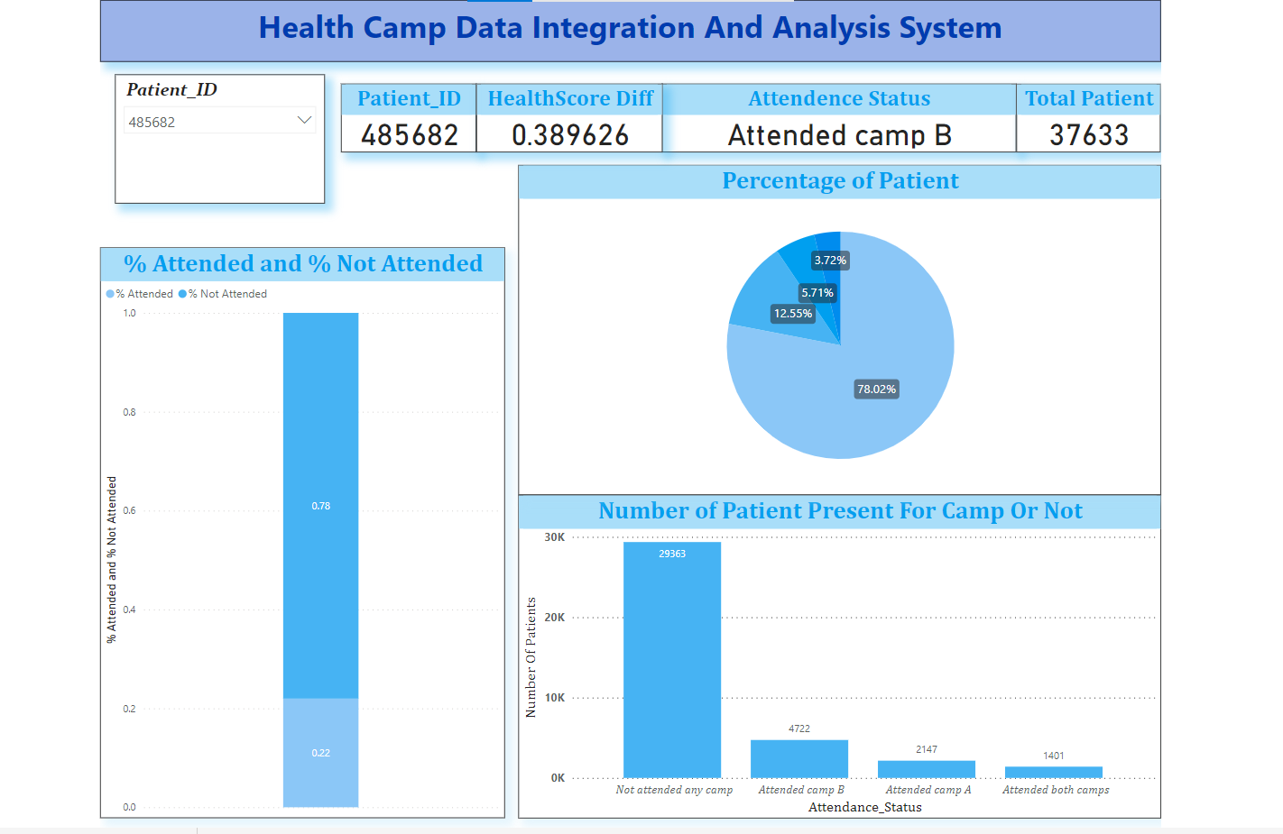
Insights and Visualization:
Visualization

Slide 7

THANK YOU

